Slide 1
Statistical Strategic Classification
An Implementation of Strategic Predictions
Michael Asante

Slide 2
What is Classification?
Classification, in the context of Machine Learning, is the assignment to a given data sample: a label from a given class. The assignment is computed from the sample’s feature values.
Consider a social media site. When a user posts something, an algorithm assigns a class label: spam or non-spam. This is determined from different variables such as word count, capital letters, links, etc. The separation between spam and non-spam is classification and the algorithm is called a classifier.

Slide 3
Strategic Classification
In machine learning, the underlying classifier is preferably kept secret. However, in practice, the classifier is sometimes known or implied. Because of this, actors will attempt to ‘game’ the classifier to achieve an optimal classification.
Using the previous example, suppose a user’s post was identified as spam but somehow the user knows how the classifier works. The user, who aims to achieve a non-spam classification, will try to game the classifier in order to achieve their goal.

Slide 4
Stackelberg Competition
What was described earlier is called a Stackelberg competition, where the publisher of the classifier can act on her strategy first, while the actor responds to the classifier. The publisher acts like a market leader.
The purpose of this game is to achieve a Stackelberg equilibrium, where the publisher achieves the highest payoff, given the optimal response of the actor and is no longer able to respond.

Slide 5
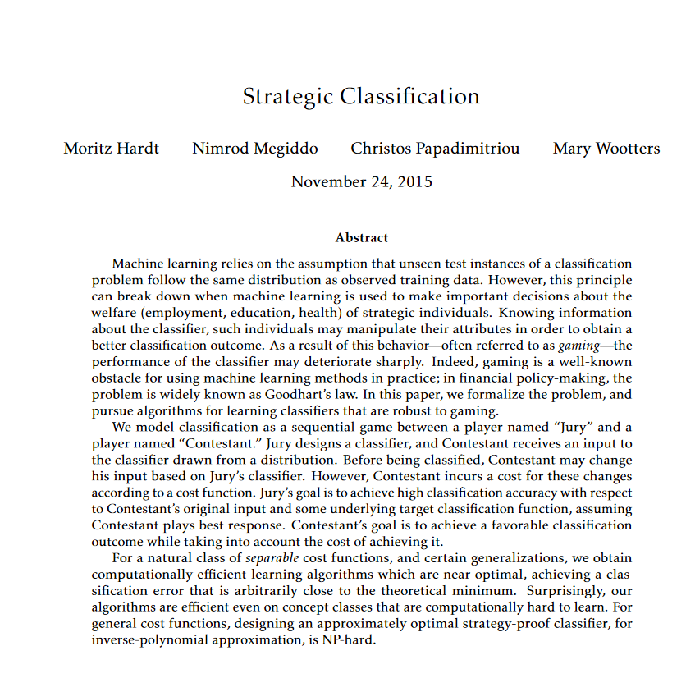
Motivations
After taking CSC-333: Machine Learning, I had an interest in game theory and machine learning. Eventually, I found the paper “Strategic Classification” by Hardt et al. which discusses these topics.

Slide 6
The Model Used
We introduce two players:
Jury – The one who publishes a classifier
Contestant – the individual(s) who games the variables to achieve a preferred classification.
The Contestant takes a given sample, sees the sample classification, and modifies the feature data to achieve an optimal result.
When the Contestant games the classifier, it is done at an inherent cost. The Contestant has a certain budget which she can spend to game.

Slide 7
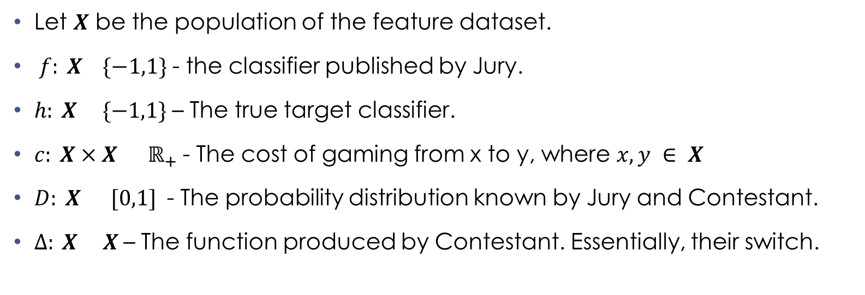
The Model Definitions (Definition 1.1 [HMPW’16])
Let $X$ be the population of the feature dataset.
$f: X \{−1,1\}$- the classifier published by Jury.
$h: X \{−1,1\}$– The true target classifier.
$c: X×X ℝ_{+}$- The cost of gaming from x to y, where $x,y ∈ X$
$D: X [0,1]$- The probability distribution known by Jury and Contestant.
$∆: X X$– The function produced by Contestant. Essentially, their switch.

Slide 8
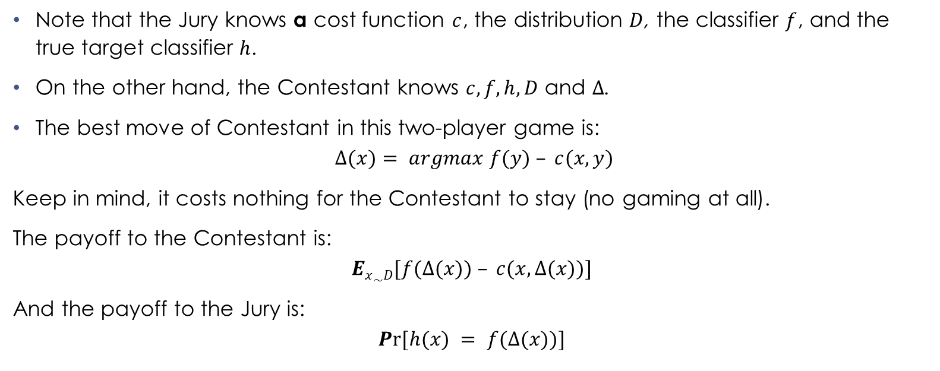
The Model Definitions (cont.) (Definition 1.1 [HMPW’16])
Note that the Jury knows a cost function $c$, the distribution $D$, the classifier $f$, and the true target classifier $h$.
On the other hand, the Contestant knows $c, f, h,D$ and $∆$.
The best move of Contestant in this two-player game is:
$$∆(x)= argmax f(y) – c(x,y)$$
Keep in mind, it costs nothing for the Contestant to stay (no gaming at all).
The payoff to the Contestant is:
$$Ex\sim D[f(∆(x)) – c(x, ∆(x))]$$
And the payoff to the Jury is:
$$Pr⁡[h(x) = f(∆(x))]$$

Slide 9
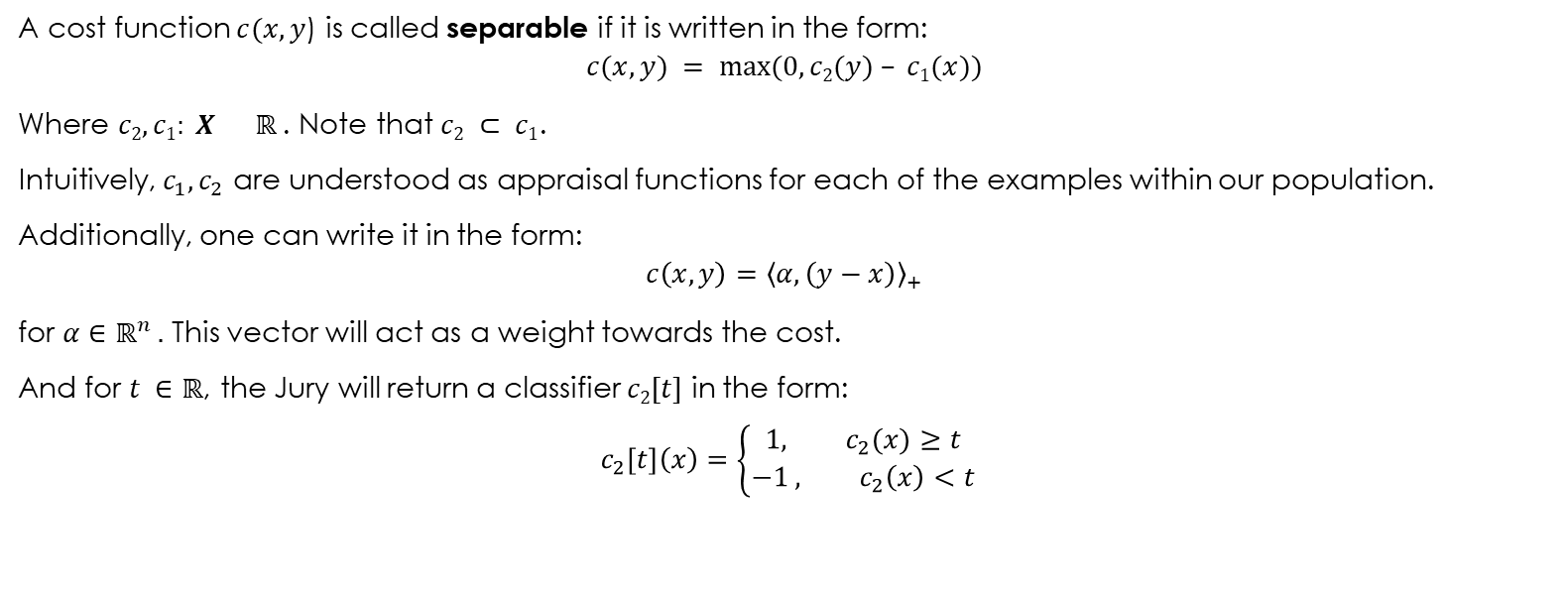
Separable Cost Functions and its Definitions [HMPW’16])
A cost function $c(x,y$) is called separable if it is written in the form:
$$c(x,y) = max⁡(0,c2(y) – c1(x))$$
Where $c2, c1: X ℝ$. Note that $c2 ⊂ c1$.
Intuitively, $c_{1},c_{2}$ are understood as appraisal functions for each of the examples within our population.
Additionally, one can write it in the form:
$$c\left(x,y\right)={\left\langle α,\left(y−x\right)\right\rangle }_{+}$$
for $α∈ℝ^{n} .$ This vector will act as a weight towards the cost.
And for $t ∈ℝ$, the Jury will return a classifier $c2[t]$ in the form:
$$c_{2}[t]\left(x\right)=\left\{\begin{aligned}1, c_{2}(x)≥t \\ −1 , c_{2}\left(x\right)<t\end{aligned}\right.$$

Slide 10
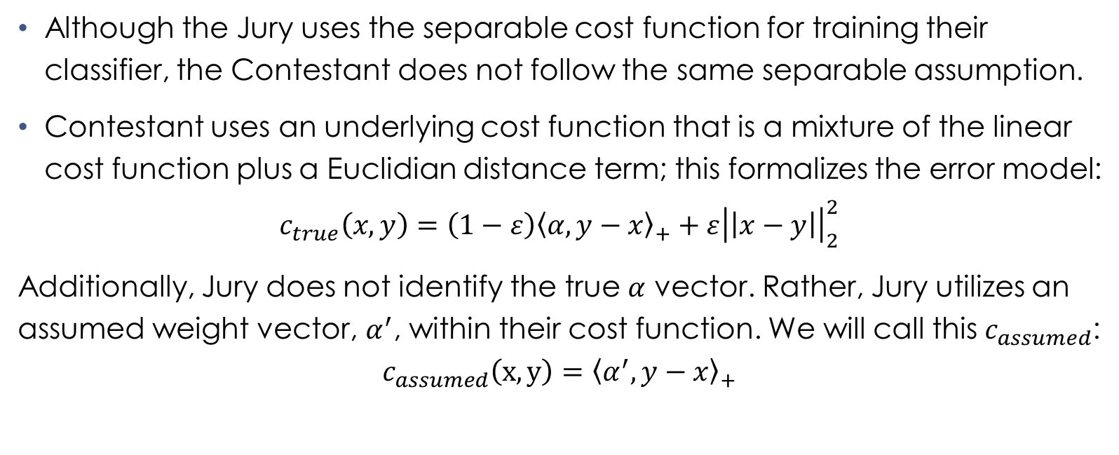
Separable Cost Functions and its Definitions (cont.) [HMPW’16])
Although the Jury uses the separable cost function for training their classifier, the Contestant does not follow the same separable assumption.
Contestant uses an underlying cost function that is a mixture of the linear cost function plus a Euclidian distance term; this formalizes the error model:
$$c_{true}\left(x,y\right)=\left(1−ε\right){\left\langle α, y−x\right\rangle }_{+}+ε{\left|\left|x−y\right|\right|}_{2}^{2}$$
Additionally, Jury does not identify the true $α$ vector. Rather, Jury utilizes an assumed weight vector, $α^{′}$, within their cost function. We will call this $c_{assumed}$:
$$c_{assumed}\left(x,y\right)={\left\langle α^{′}, y−x\right\rangle }_{+}$$

Slide 11
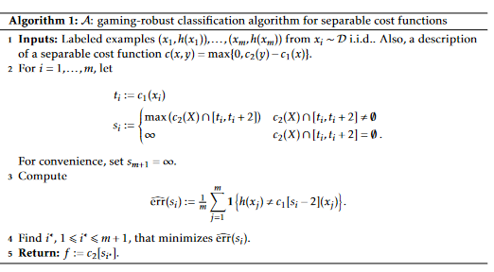
The Algorithm! [HMPW’16]
Now I will discuss the gaming robust classification algorithm used in the implementation.

Slide 12
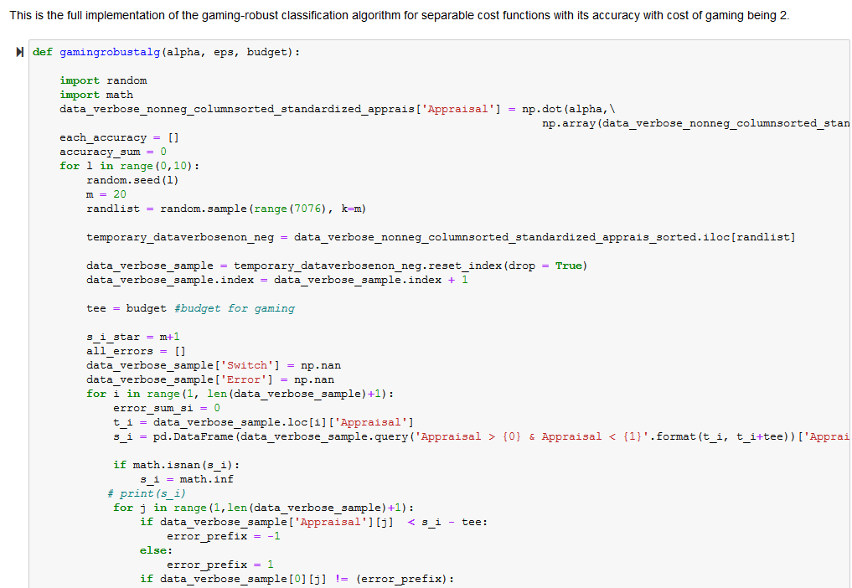

Implementation of gaming robust algorithm with 2 units of gaming
The Apontador dataset used in the paper (Costa et al.) was also utilized in my python implementation. Different values varied such as the weight vector $α^{′}$ and $ε$ values.

Slide 13
Findings
I learned how to read a research paper. Researchers assume that the readers have underlying knowledge of the topic being presented.
Machine learning uses a lot of linear algebra.
The paper was mathematically rigorous in its proofs; however, the implementation had fewer details.
Issues of implementation: Ambiguous cost function, the role of one variable instead of two; ambiguous selection of ‘true’ weight vector (alpha); the ambiguous quantification of the non-linear component (epsilon).
Further works include utilizing different weight coefficients to achieve higher accuracy, implementing different hybrid approaches, allowing the Jury to relax their separable assumption, and the use of strategic learning in security games.

Slide 14
Acknowledgments
I would like to thank Professor Joseph Alfano for mentoring and helping me to understand the paper. He has been instrumental to my learning through the past couple of months.
Professor Leamarie Gordon and Professor Benjamin Knurr for organizing the Undergraduate Symposium during COVID. Additionally, the Office of Provost, Dr. Gregory Weiner, for funding this event.
My friends and family for emotional support.
Thank you for coming to my talk!

Slide 15
Questions?

